Slide 1
Maryville R-II School District
Area Cooperative for Educational Support
And
The Learning Center
Behavior Intervention Strategies for the Traveling School Social Worker
Presented at the SSWAM Fall
Conference,
October 16, 2015

Slide 2
Presenters….
Debbie Griffith Fujinami, School Social Worker
Master of Social Work (MSW); Licensed Clinical Social Worker (LCSW)
Assigned to Nodaway Holt School District, South Holt School District, Mound City School District, Craig School District, Fairfax School District, Rock Port School District= approx. 1331 students
Lisa Christmas, School Social Worker
Master of Social Work (MSW); Licensed Clinical Social Work (LCSW), Certified Trauma Specialist (CTS)
Assigned to Avenue City School District, Pattonsburg School District, Albany School District, Stanberry School District, King City School District, Northeast Nodaway School District, Jefferson School District, and Head Start = approx. 2089 students
Tammy Oltman, School Social Worker/Coordinator
Master of Social Work (MSW); Licensed Clinical Social Work (LCSW), IA Licensed Independent Social Worker (LISW)
Tammy is currently the School Social Worker/Coordinator for The Learning Center (an alternative educational program for the Maryville R-II School District)

Slide 3
Get to Know
How many buildings do you cover?
Size of your district?
What do you do?
What grade level do you serve?

Slide 4
Maryville school district
Approximately 1436 students
Rural Northwest Missouri-NWMSU is located in the ‘ville
2014 Full School Psychologist
2015 Full time SW for Elementary
5 buildings
1 Elementary (Pre K-4)
1 Middle School (5-8)
1 High School (9-12)
Tech school
GO Program-before and after school program
The Learning Center Alternative Educational Program
ACES

Slide 5
The Learning Center
1 Coordinator/Social Worker
2 Special Education Teachers
Paraprofessional
Administrative supports from Tech School
Currently 7 students with maximum of 12
K-8 Maryville Students
Referrals through the special education process based on social, emotional, and behavioral concerns
Therapeutic modality
Not bound by constraints of a traditional school

Slide 6
What exactly is ACES?
A consortium of 21 school districts located in 8 counties in northwest Missouri.
The Area Cooperative for Educational Support (ACES) is committed to providing a full continuum of special education and at-risk services for students in member districts from pre-school through 12th grade, as well as, to build the capacity of the educators and school systems in addressing the issues that interfere with educational outcomes.
ACES is a comprehensive program that empowers students to address behavioral/emotional difficulties and academic issues that block their success in order to become healthy, productive members of society.
ACES began as an educational cooperative, then expanded with an alternative school and in 2009 out based social work services began. In 2013, Maryville School District opened their own alternative school (The Learning Center). ACES continues to serve the 21 district co-op with 3 social workers, a diagnostician, a part time secretary, and a director. ACES is currently contracting for school psychologist services through Missouri School Board Association. ACES manages and coordinates contracts for speech, occupational therapy and physical therapy for the districts.

Slide 7
Current ACES Services
School based mental health services (SBMH)
School districts within the co-op are able to contract for the amount of time they want social workers – this ranges from 1 day a month to 2 days a week (8 days a month)
Educational diagnostician services including assessments and testing
Special Ed compliance and consultation
Contract agents for occupational therapy, physical therapy and speech therapy services
Contract for school psychologist services
Mental Health lending library
Professional development for district staff
Consultation/collaboration with multiple agencies to improve student outcomes
Crisis support services for districts
*These services are provided over a large geographical area….

Slide 8
Roughly the Size of Connecticut.
And includes about 6,500 students, K-12.

Slide 9
ACES Cooperating School Districts
Albany | Northeast Nodaway
Avenue City | Pattonsburg
Craig | Rock Port
Fairfax | South Holt
Jefferson | South Nodaway
King City | Stanberry
Maryville* | Tarkio
Mound City | Union Star
Nodaway- Holt | West Nodaway
North Andrew | Worth County
North Nodaway | *Fiscal Agent District
Districts range in size from 67 students to 1,400 students K-12

Slide 10
Tier 3
Intensive Intervention (5%)
Tier 2
Early Intervention (15%)
Tier 1
Universal Intervention (80%)

Slide 11
Examples of behavior seen at each tier of the pyramid – it is not an all-inclusive list!
Unsafe behavior that is both frequent and intense, or so intense it is alarming; biting, bolting, aggression to self or others with intent to harm or maim, extreme truancy, safe schools violation
Consistent non-compliance, office referrals for defiance in classroom, possibly fighting at school, truancy, and many other behaviors that are time-consuming and can be resistant to short-term change or intervention.
Lack of work completion, tardy to school, occasional disrespect in the classroom or to authority figures, displays of temper that are over relatively quickly, peer to peer issues, and other behavior that is generally expected for the age, but can be occasionally disruptive.

Slide 12
Services Available to Member Districts
Tier 1-Universal Prevention (all students; 80-90%) | Tier 2-Early Intervention (5-10% of students) | Tier 3-Intensive Intervention (1-5% of students)
School wide positive behavior support School wide character education/social skills Increase school staff, parents and public knowledge of mental health issues in our area | School Based Intervention Team Assistance Agency Collaboration/Referrals Family Contact Behavior Intervention Parent Support/Education Individual/Group Counseling Training on Behavior Support, At-risk Interventions, Mental Health, etc. Autism Education and Consulting | Alternative School Placement Parent Support/Education Special Education Services Transition Support Recovery Room Refer to School Psychologist

Slide 13
Research Based and/or Effective Programs that can be Utilized in Schools
Big Brothers Big Sisters
Check and Connect
Cognitive Behavioral Therapy
Computer Assisted Instruction
Cooperative Learning
Differentiated Instruction
Olweus
Social Thinking (Michelle Garcia Winner)
First Step to Success
Parents as Teachers
Public Achievement
Reconnecting Youth
Second Step: Violence Prevention Curriculum
Second Step: Steps to Respect Bullying Prevention Program
Skill Streaming
Brain Gym

Slide 14
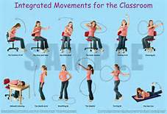
VIDEO
Second Step
Steps to Respect
www.braingym.com
https://www.youtube.com/watch?v=wrgp9cpYyLo

Slide 15
School Based Mental Health Service Access
General Process:
Usually teacher or counselor have concerns regarding student.
Teacher/counselor/principal fill out SBMH referral packet and consult with school social worker assigned to their district.
Depending on concerns
meetings are scheduled
observations are scheduled
creative, personalized interventions are designed that are based on need, flexibility, and feasibility.

Slide 16
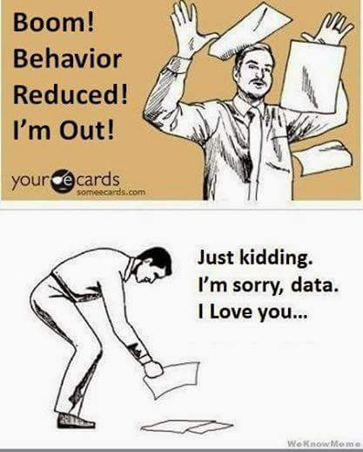
Data Collection and Why?
When we don’t know why a behavior occurs, we collect data
Data should be collected on specific, targeted behaviors
How often they occur (frequency)
How severe they are (intensity)
Where they occur
When they occur

Slide 17
ABC chart

Slide 18
Data Collection Chart

Slide 19
Monthly Calendar

Slide 20
School based intervention team meeting (SBIT)
Determine time and place
Key players (administrator, core teacher, special education staff, guidance counselor, school social worker, other staff, other relevant agencies)
Team approach-brainstorm
Focus on strengths
Prioritize one or two target behaviors
Set measurable, realistic goals

Slide 21
SBIT Forms

Slide 25
Follow Up
Team reconvenes in 4-6 weeks after initial SBIT
Research shows that it takes at least 21 days to change a habit
Must be administered with fidelity and consistency
Review data
Re-evaluate behavior interventions and deem if successful
Determine if continue with current interventions or change
http://www.aces.maryville.k12.mo.us/forms.html

Slide 26
Tier 3-SBMH Team Meeting
If the intensity and frequency of behavior persists or is deemed unsafe, explore other options…..school psych referral, alternative school placement, special education referral, etc.
This results in a school placement change for the student to be able to meet their needs
This is a team decision
The student will continue to have behavioral, emotional, and academic interventions
Social work mental health services will also continue

Slide 27
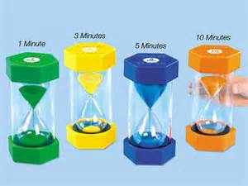
BREAK
https://www.youtube.com/watch?v=E3IM0AdQLLQ

Slide 28
Interventions

Slide 29
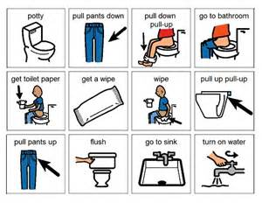
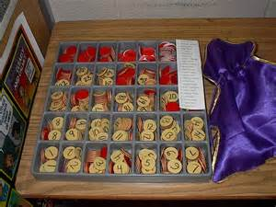
Behavior systems
Behavior Charts
Visual charts/schedule
Response Cost – give student tokens beginning of day and take away
Token system – give tokens for appropriate behaviors

Slide 30
Behavior charts

Slide 32
TLC’s Star Chart-Elementary

Slide 33
TLC’s Star Chart-Middle School

Slide 34
POSSIBLE REWARDS
• Choose any class job for the week
• Choose music for the class to hear
• Sit in teacher’s chair for a day
• Choose stickers
• Class field trip
• Clean the erasers
• Decorate bulletin board
• Do half of an assignment
• Draw a picture
• Draw from "grab bag"
• Earn class party
• Earn points for a class video.
• Earn tickets toward free time.
• Eat at special table
• Eat lunch outside on a nice day
• Eat with a friend in the classroom
• Enjoy a game with a friend
• Enjoy a positive visit with the principal
• Extra time at recess
• Have work posted in the hall
• Help clean up classroom
• Help in a classroom of younger children
• Hide a special note in desk
• I-Pad time, use I-pod, computer time
• Keep a stuffed animal at desk
• Leader for the day.
• Listen to the radio or CD with headphones
• Make a bulletin board
• Make ice cream sundaes
• No-homework passes
• Operate a film projector or other equipment
• Pick a game at recess / P.E
• Pick something from the prize box.
• Pick something from the treat box. • Play "teacher"
• Play with play dough, moon sand
• Playing card games
• Points that can be redeemed for prizes

Slide 35
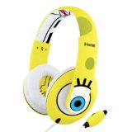
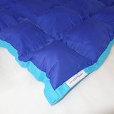
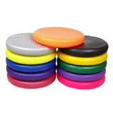
External supports
Weighted Lap Blankets/Lap Belts
Make your own
www.southpaw.com over $100
Bear Hug Vest
www.southpaw.com $74-101
Weighted Vest
www.southpaw.com $160-185
MotivAiders $50
Wiggle Seats $11.25
Exercise Balls $10-25
http://bangordailynews.com/2013/06/03/health/replacing-classroom-chairs-with-stability-balls-benefits-students-study-finds/
Timers
Headphones

Slide 36
Time with people
Lunch with staff
Cookies with counselor
Time with an older student/adult
Shoot hoops with the principal
Teacher helper
Lunch w/friends/peers
Pairing with another student
Tutoring
Cadet Helper
Study Buddy

Slide 37
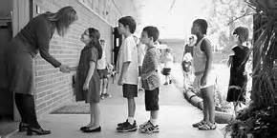
Preventative interventions
Check and Connect
Check in/check out
Triage
Mentoring
Greet every student daily
Overlearning (Practice 10 times)
Social Stories (books / video – can make personal)
Check in every 5 minutes at recess / unstructured time
Squeeze time
Safe spot/Time out room

Slide 38
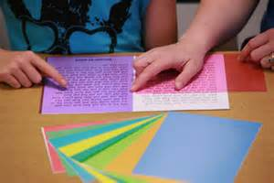
Altering classroom work
Reducing work problems
Odds/evens
Extended time
Quiet place to work/take a test
Scribe
Chunk assignments
Preferential seating/quiet/safe spot
One step/direction at a time (no multi-steps)
Choices (give them 3, let them pick 1)
Oral instead of writing
Increase time to complete
Take late without a deduction
Test out
Ruler to help follow
Colored overlays

Slide 39
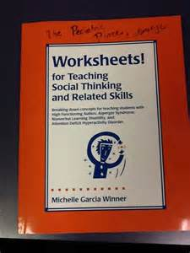
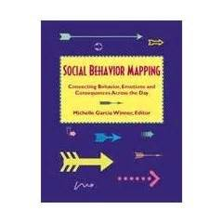
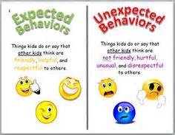
Social Thinking
Michelle Garcia Winner
Zones of Regulation
5 is Against the Law
Social Mapping
Incredible Flexible You

Slide 40
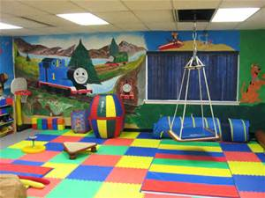
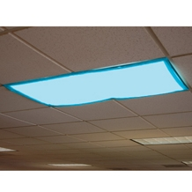
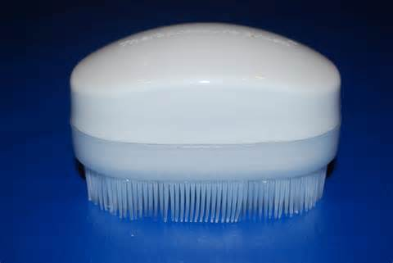
Sensory
Velcro
Squeeze time
Muscle Relaxation
Brushing
Joint compressions
Swing
Trampoline
Sensory boxes
Lighting-use lamps or get light covers
https://www.therapyshoppe.com/category/P2284-fluorescent-light-covers-filters
Noise
Heavy Work Load
Bands on Chair legs
Gum, mints, suckers

Slide 41
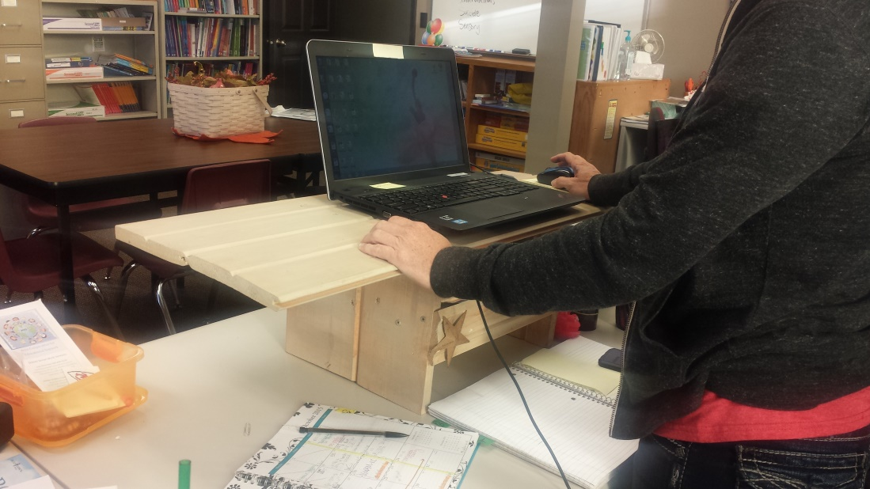
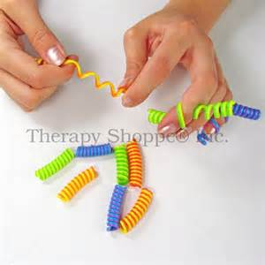
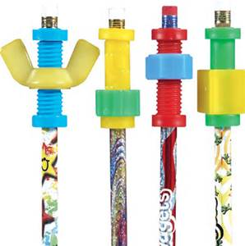
Miscellaneous
Tape around desk
Fidget toys
Secret code
Race against clock
Stand up desk
Talk tickets / sticks
Model appropriate behavior
Praise, praise, praise

Slide 42
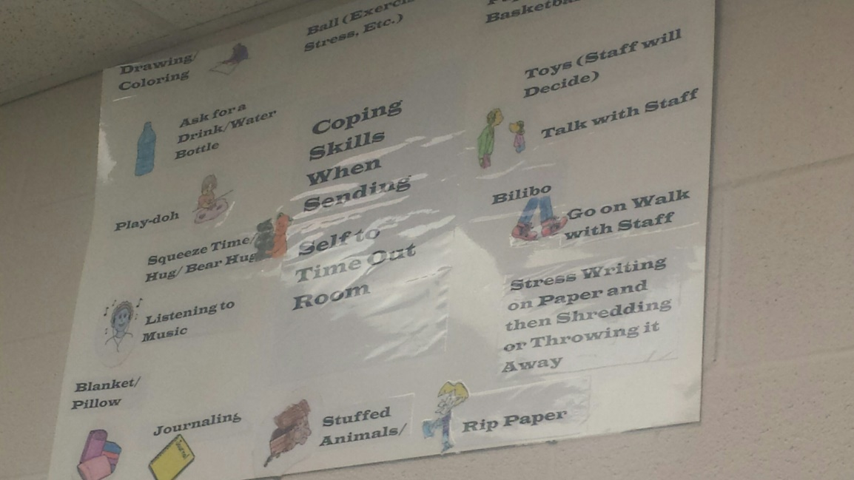
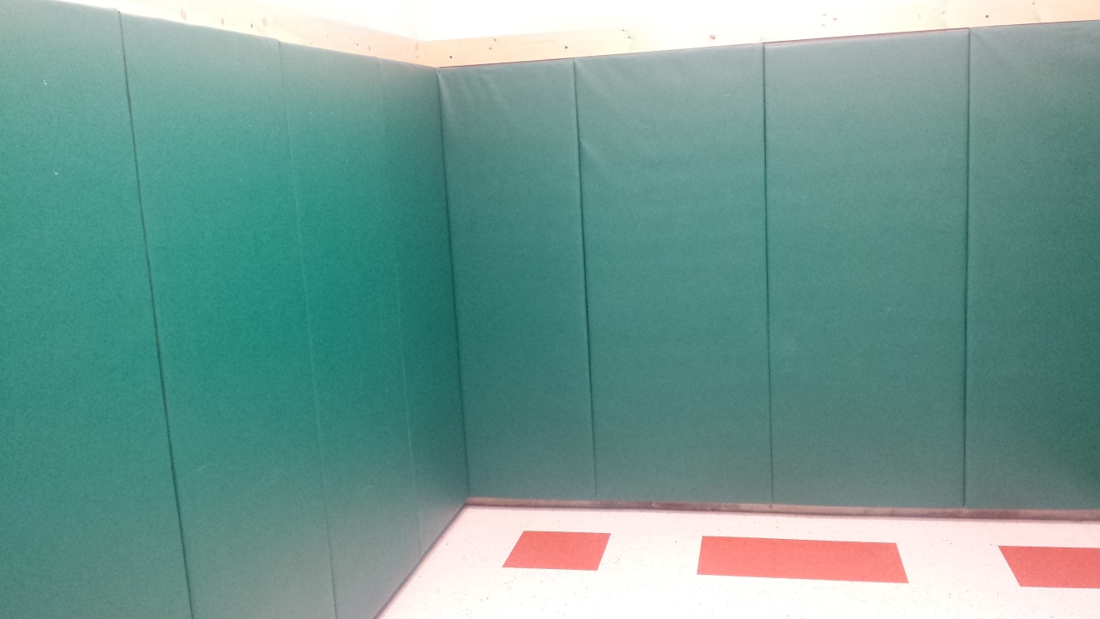
Time out Room

Slide 43
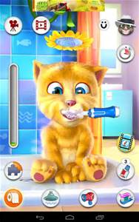
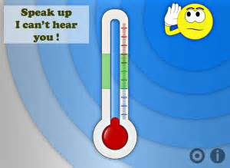
Resources
IPAD
Computers
www.gonoodle.com
http://braingym.com

Slide 44
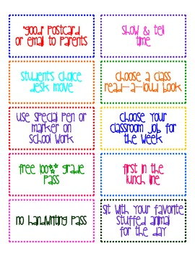
Rewards/Incentives
Class rewards
Target kid can earn reward for entire class

Slide 45
For more information about our School Based Mental Health services, please contact:
Lisa Christmas lisachristmas@maryville.k12.mo.us
Debbie Griffith Fujinami dfujinami@maryville.k12.mo.us
For more information about The Learning Center, please contact: Tammy Oltman oltman@maryville.k12.mo.us
For more information about the ACES program contact:
Tamara Lynn, ACES Director
(660)582-3768
lynnt@maryville.k12.mo.us
http://www.aces.maryville.k12.mo.us/

